Slide 1
Homomorphic Encryption for Secure Evaluation of Images
Activity 26
Final Presentation

Slide 2
Agenda
Abstract
Introduction
Problem Statement
Significance of Study
Objective
Design Process
Requirements
Scope
Development Process
Tools
Technical Description of the Project
Testing and Results
Summary and Conclusions
References

Slide 3
Abstract
Homomorphic encryption is a cryptographic innovation enabling secure computation over encrypted data.
It holds significant potential for addressing privacy concerns in Convolutional Neural Networks (CNNs), especially when handling sensitive image data.
The project aims to explore the practical application of homomorphic encryption, specifically for ensuring the secure evaluation of CNNs on sensitive image datasets.
This exploration aims to contribute to the overall advancement of privacy-preserving machine learning techniques.

Slide 4
Introduction
Fully homomorphic encryption (FHE): Fully Homomorphic Encryption (FHE) is a cryptographic breakthrough allowing computations on encrypted data without decryption, making it ideal for secure machine learning with sensitive data.
Google Colaboratory, a cloud-based ML platform, simplifies the entire ML process—from model creation and training to deployment. It offers streamlined functions for managing and monitoring ML models.
In the context of ML, FHE finds a practical application through Google Colaboratory, ensuring the secure handling of sensitive data.

Slide 5
Introduction
Combining FHE with Google Colab enables secure, real-time inference on encrypted data. This powerful synergy allows organizations to deploy and decrypt ML models seamlessly.
Real-time applications showcase FHE encrypting data for secure predictions in various sectors such as finance, healthcare, and government.

Slide 6
Problem Statement: Balancing Data Utility and Security in Machine Learning
Challenge: Organizations face a dilemma to protect sensitive data and utilize it for machine learning applications.
Traditional Approach: Current machine learning methods require data encryption before use, making data vulnerable during processing.
Privacy-Preserving Need: Crucial for highly regulated environments where predictions use encrypted data, decrypted only by the end consumer (client side).

Slide 7
Objectives
The project uses FHE and Google Colab to develop a scalable pipeline for performing machine learning model inference on encrypted data while keeping it encrypted through the entire process.
Goal: Build a scalable Fully Homomorphic Encryption (FHE) pipeline on Google Colab to enable model inference on encrypted data without requiring decryption.

Slide 8
Objectives
Use Case: Perform encrypted evaluation on MNIST handwritten digit examples using a convolutional neural network.
Steps : Leverage Google Colab to explore and prepare the MNIST data.
Train a convolutional neural network model on the data.
Deploy the trained model to an endpoint.

Slide 9
Objectives
Architecture: Client application encrypts data before sending for processing
Model performs classification on encrypted data within an isolated T4 GPU kernel
Model outputs an encrypted prediction that can optionally be decrypted
Encryption : Data remains encrypted end-to-end, even at runtime within the T4 GPU processor.

Slide 10
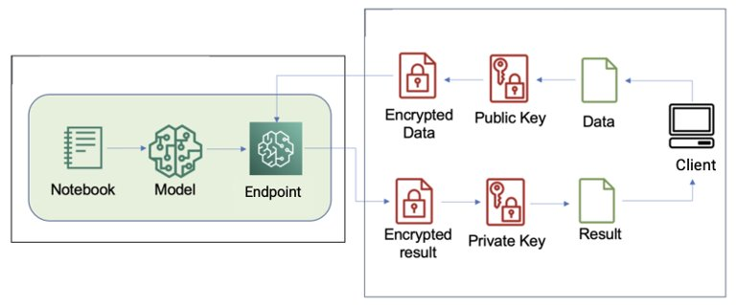
Objectives
Outcomes: Showcase how FHE allows model inference without decryption
Utilize Google services to enable privacy-preserving machine learning at scale.

Slide 11
Design Process
The goal is to enable confidential data analytics leveraging homomorphic encryption integrated with scalable cloud machine learning infrastructure. Use cases focus on healthcare applications meeting regulatory privacy requirements.
Clients handle local encryption/decryption while computation on encrypted data happens in isolated cloud environments. The Microsoft SEAL library provides efficient leveled homomorphic encryption capabilities. It represents plaintext as polynomial mathematical structures encrypted into polynomial ciphertexts.

Slide 12
Design Process
Our customized PyTorch integration enables private model training and inference directly on these polynomial encodings. By generating encryption keys and transmitting them to manage access, data remains fully secured end-to-end.
On the implementation side, configuring cloud notebooks, storage protocols, ML customizations, and networking is required. There is tuning of schemes balancing security, accuracy and performance. Modular components sustain an integrated pipeline between the client, framework, and cloud.

Slide 13
Design Process
We prioritize performant real-time clinical inferencing as the first application, demonstrating practical deployment. Longer-term, supporting expanded use cases across industries is targeted. Meeting regulatory needs is essential.
Overall this confidential computing approach aims to unlock data analytics in fields like healthcare while keeping critical information encrypted at every stage leveraging innovations in cryptography, cloud infrastructure, and machine learning.

Slide 14
Requirements and Tools
Requirements
Tools
TenSeal
Numpy
Pytorch
Matplotlib
Google Colaboratory
SEAL
HELib
Google Drive

Slide 15
Requirements
TenSeal serves as the foundation library for developing privacy-preserving machine learning models.
Through its interface to the SEAL cryptography library, it integrates homomorphic encryption capabilities with PyTorch, allowing neural networks to be built and trained directly on encrypted data without decryption.

Slide 16
Requirements
PyTorch is a deep learning framework designed to create complicated Convolutional Neural Network topologies for encrypted picture classification applications.
It uses GPU acceleration to efficiently train models on huge encrypted datasets utilizing TenSeal's encrypted operations.

Slide 17
Requirements
NumPy: NumPy is a Python library that supports the intensive linear algebra and numerical computations required for developing, training, and assessing machine learning models.
It makes it easier to operate on the encrypted data tensors and matrices that underpin the encrypted modeling workflow.
Matplotlib: Matplotlib assists in the visualization and interpretation of encryption model training and evaluation data.
It allows you to analyze the encrypted learning process by plotting key metrics like loss and accuracy, which aids in model selection and hyperparameter optimization.

Slide 18
Scope
The goal of this project is to develop a scalable and practical approach for securely evaluating Convolutional Neural Networks (CNNs) on sensitive image datasets using Fully Homomorphic Encryption (FHE).
Develop a confidential machine learning solution using Google Colab and FHE that enables encrypted predictions on sensitive datasets. This involves integrating FHE into Colab, utilizing the SEAL library for encrypted computations, and showcasing an end-to-end encrypted ML pipeline.

Slide 19
Scope
Enable previously impossible private analytics for regulated industries like healthcare, finance and government by exploring optimizations to make FHE practical. Additionally, investigate expanding the technique to encrypted model training for advanced applications.

Slide 20
Tools
The HELib Python library interfaces with SEAL's cryptography methods, making encryption operations in Python/PyTorch easier. HELib makes it easier to encrypt/decrypt data and do encrypted inferences using SEAL.
Google Drive is used to store encrypted datasets, models, and code versions on the cloud. Drive ensures that encrypted data/models are easily accessible during collaboration from any browser.

Slide 21
Tools
Google Colaboratory offers a browser-based environment for building models with frameworks such as PyTorch. Its GPU acceleration enables fast model training and experimentation. The GPUs used by Colab accelerate model training on huge encrypted datasets as well as real-time encrypted inferences.
The underlying homomorphic encryption is powered by Microsoft's SEAL library, which allows computations to be done directly on encrypted data.SEAL creates the encryption keys required for computations on ciphertexts, such as public/secret keys.

Slide 22
Technical Description of Project
TenSEAL is an open-source library for Privacy-Preserving Machine Learning using Homomorphic Encryption that can be easily integrated within popular machine learning frameworks.
TenSEAL uses lattice cryptography to compute encrypted data without first decrypting it. TenSEAL relies on the implementation of the CKKS scheme in Microsoft SEAL.
CKKS is especially designed for approximating computations on encrypted floating-point numbers
Notes:
I will now provide an overview of the technical details of our project. We utilized an open-source library called TenSEAL for implementing privacy-preserving machine learning using homomorphic encryption. TenSEAL relies on Microsoft SEAL's implementation of the CKKS cryptographic scheme which allows approximate computations on encrypted floating point numbers.

Slide 23
Technical Description of Project
The TenSEAL context is the central component of the library. It generates and stores the necessary keys required by an encrypted computation.
The context generates the secret-key used for decryption, the public-key used for encryption, the Galois-keys used for rotation, and the relinearization keys used for relinearization of ciphertexts.
This same object will also handle the thread-pool and for automatic ciphertext relinearization and rescaling during computation.
Notes:
The central component of TenSEAL is the context which generates and stores encryption keys required for computations on ciphertexts. It produces the secret key for decryption, public key for encryption, rotation keys, and relinearization keys.

Slide 24
Technical Description of Project
In the project, direct operations are performed on the ciphertext data that are encrypted with public keys, producing encrypted predictions.
The CNN model performs feature extraction and classification directly on these encrypted polynomials.
Results are transmitted back encrypted to be decrypted only at the endpoints using FHE private keys.
This project utilizes the MNIST database (open source) of 70,000 small 28x28 pixel grayscale images of handwritten digits 0-9.
Notes:
In our project, the CNN model directly operates on encrypted input data to generate encrypted predictions. The encrypted results can only be decrypted at the endpoints using FHE private keys.

Slide 25
Technical Description of Project
We applied the Image Block to Columns (im2col)technique, which turns a convolution layer into a single matrix multiplication operation.
This technique requires encrypted matrix-plain vector multiplication, which we implemented by performing element-wise multiplication of the matrix transpose with replicated plain vector.
Notes:
We applied the image to column technique to turn convolution layers into matrix multiplications for efficiency. This requires multiplying the encrypted image matrix with the plaintext filter matrix.

Slide 26
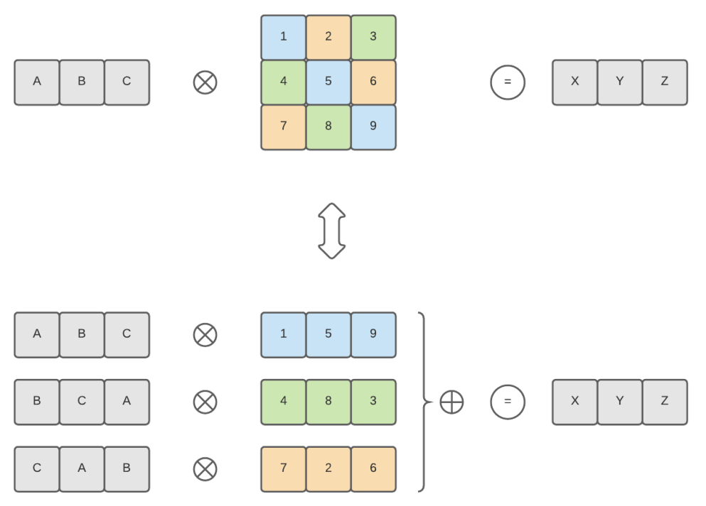
Technical Description of Project
Figure shows how an encrypted vector (in gray) can be multiplied with a plain matrix, but this has a lot of computational cost.
Notes:
Figure shows how we could an encrypted vector (in gray) can be multiplied with a plain matrix, but this has a lot of computational cost.

Slide 27
Technical Description of Project
2D convolution can be performed using a single matrix multiplication, instead of repeating multiplication on every window.
This method is referred to as image block-to-column convolution or image-to-column convolution.
It first reorganizes the input matrix into rows representing convolution windows, then performs a dot product
Notes:
2D convolution can be performed using a single matrix multiplication, instead of repeating multiplication on every window.
This method is referred to as image block-to-column convolution or image-to-column convolution.

Slide 28
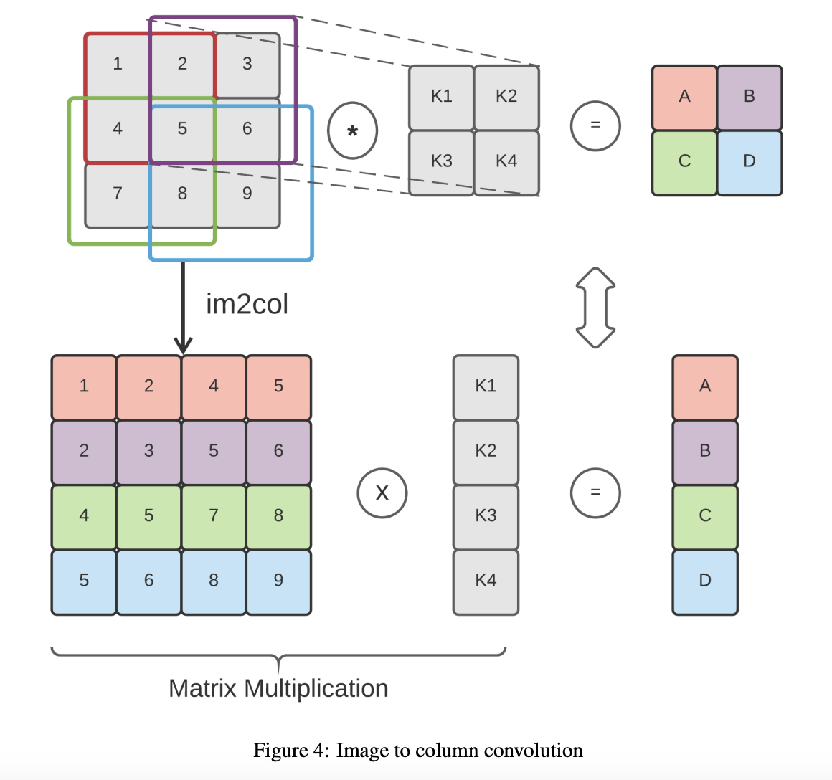
Technical Description of Project
It first reorganizes the input matrix into rows representing convolution windows, then performs a dot product
Notes:
It first reorganizes the input matrix into rows representing convolution windows, then performs a dot product

Slide 29
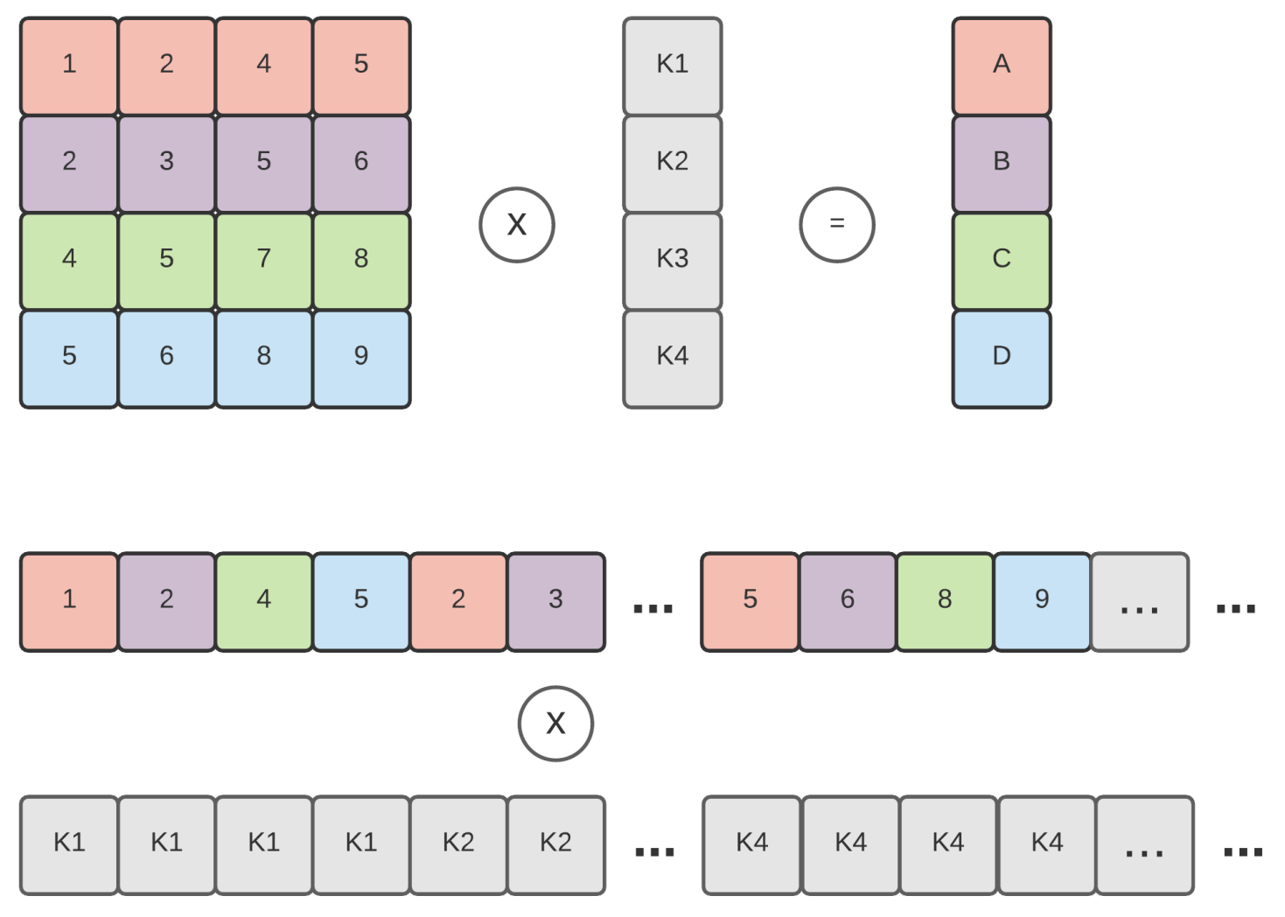
Technical Description of Project
Before encrypting the image, we first rearrange the positions of the pixels into a special order.
Now we do the encryption on this reordered image to get our ciphertext matrix.
Notes:
We first rearrange the pixel positions of the image into a special order before encryption. The encrypted reordered image is then element-wise multiplied with the plaintext filter matrix to produce the output matrix.

Slide 30
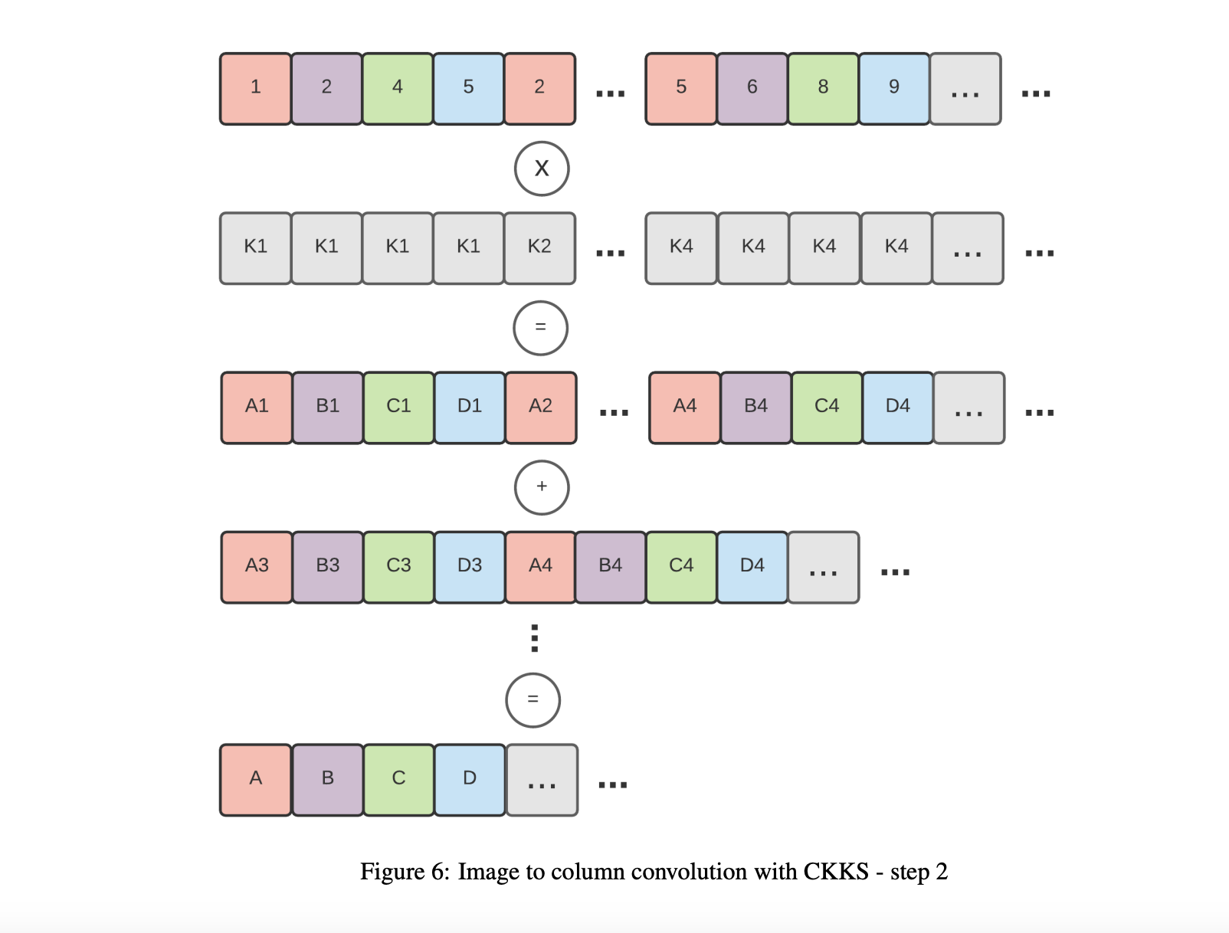
Technical Description of Project
We then do a simple element-wise multiplication between the encrypted image matrix and the plain filter matrix. This gives us an output matrix.
Notes:
We rotate this output matrix in different orientations and sum them to implement 2D convolution through a single matrix multiplication.

Slide 31
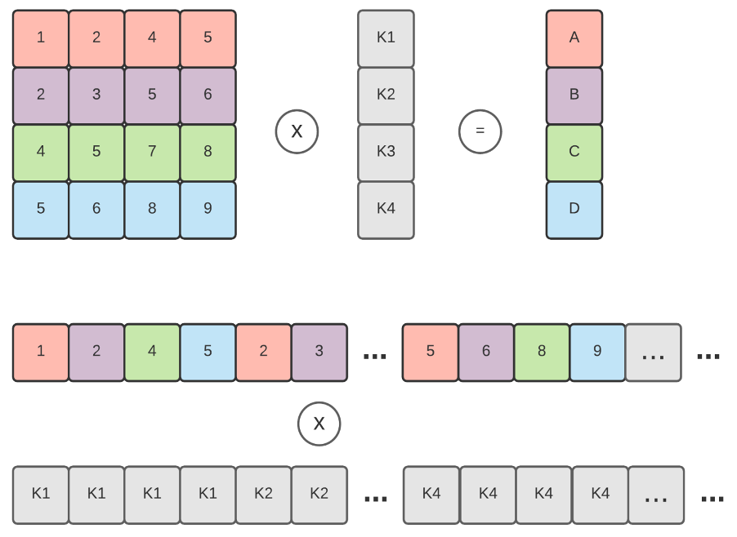
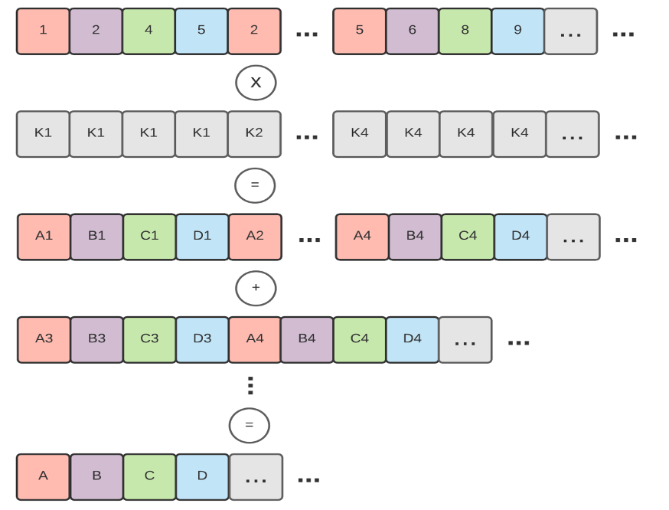
Technical Description of Project
The first shows how the encrypted matrix (colored) is encoded and multiplied with the plain kernel.
The second step is to sum different versions of the output that are rotated differently to the left.
Notes:
we prepared the image matrix beforehand by mixing up the positions of pixels in a way such that later we can decode the encrypted convolution output easily.

Slide 32
Testing and Results
To evaluate our project and technique, we implemented a neural network composed of a convolutional layer (4 kernels of 7x7, with a stride of 3x3), a linear layer (input: 256, output: 64), and a final linear layer (input: 64, output: 10).
We used the square activation function after every layer except for the last.
The convolution was done using our image-to-column implementation, while the linear layers used the dot product implementation.
Notes:
Our evaluation uses a neural network with convolutional, linear and square activation layers.

Slide 33
Testing and Results
The accuracy on the plain test set was 98% and on the encrypted test set, the encrypted model matched the original plaintext version with 99% accuracy.
Knowing that we need 6 multiplications to perform the evaluation and a security level of 128-bits, we set the polynomial modulus degree to 8192, with a coefficient modulus of 206-bits, and a scale of 21-bits.
Notes:
On the plaintext test set, it achieved 98% accuracy. The encrypted version matched this accuracy at 99% demonstrating the viability of homomorphic encryption for practical machine learning applications."

Slide 34
Summary and conclusions
Successfully incorporated homomorphic encryption into cloud ML pipeline for unprecedented security and useful insights.
Orchestrated interactions between Google Colab, isolated environments, and cryptography libraries like TenSEAL.
Encrypted end-to-end - client-side to final decryption - while evaluation happened in hardware enclaves

Slide 35
Summary and conclusions
The prototype encrypted MNIST classifier matched the 99% accuracy of the plaintext model
But overheads currently cause impractical inefficiencies, highlighting optimization opportunities

Slide 36
References
Google Colaboratory. https://research.google.com/colaboratory/
Bourse, F., Minelli, M., Minihold, M., & Paillier, P. (2018). Fast homomorphic evaluation of deep discretized neural networks. Cryptology ePrint Archive. https://eprint.iacr.org/2018/434.pdf
HomomorphicEncryption.org. (n.d.). Homomorphic encryption. https://homomorphicencryption.org/
Microsoft. (n.d.). Simple Encrypted Arithmetic Library. GitHub. https://github.com/Microsoft/SEAL

Slide 37
References
Microsoft. (2022). SEAL Developer Guide. GitHub. https://github.com/Microsoft/SEAL/raw/master/docs/SEAL_manual.pdf
NumPy. (n.d.). NumPy documentation. https://numpy.org/doc/stable/user/index.html
GitHub - OpenMined/TenSEAL: A Library for Doing Homomorphic Encryption Operations on Tensors. (n.d.). GitHub. Retrieved November 24, 2023, from https://github.com/OpenMined/TenSEAL.git

Slide 38
Thank You

